Slide 1
Quality of Interfaces
IPM 16/17
1º Assignment
Henrique Rodrigues nº42437
Pedro Costa nº42559
André Rijos nº42744

Slide 2

Xilinx ISE
Xilinx ISE is a software tool for synthesis and analysis of HDL designs, enabling the developer to synthesize ("compile") their designs, perform timing analysis, examine RTL diagrams, simulate a design's reaction to different stimuli, and configure the target device with the programmer.

Slide 3
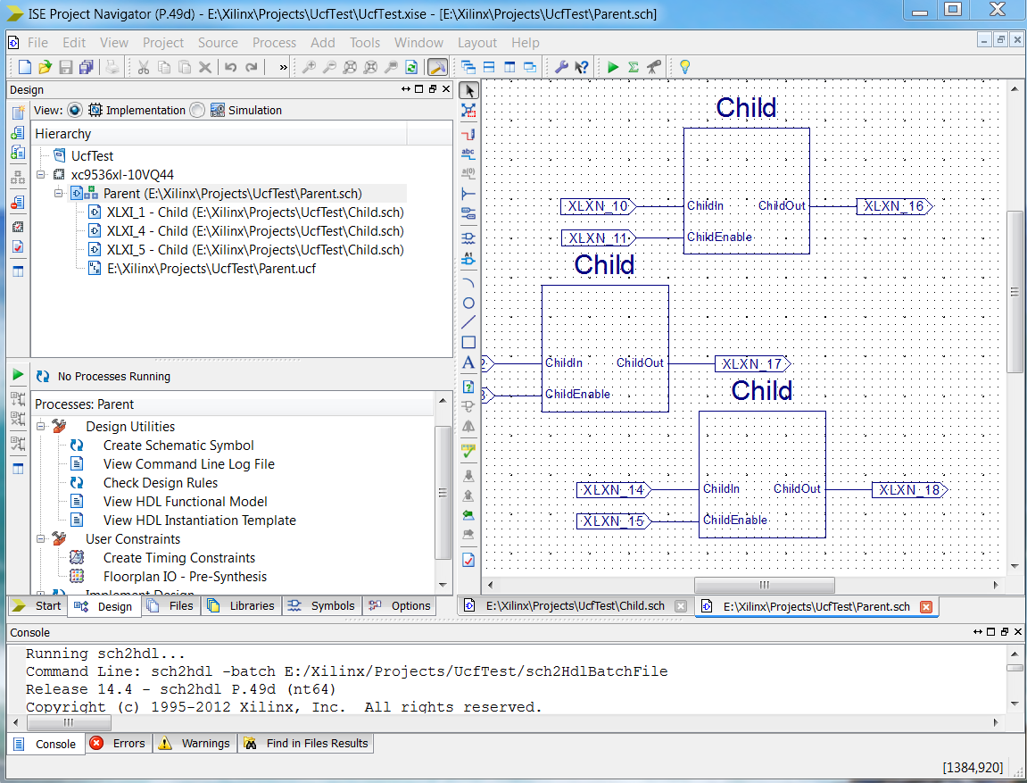
The interface however, feels rather clunky and almost hazardous to explore as most options and proper tools found themselves in sub menus inside other sub menus with almost no sort of decent explanation or search tool, making it a difficult task to navigate without any sort of previous knowledge.
Annoying apresentation;
Lackluster, almost non existent search options;
Excessive amount of sub options within other menus.

Slide 4

No Man’s Sky
No Man's Sky is an action-adventure survival video game developed and published by the indie studio Hello Games for PlayStation 4 and Microsoft Windows. The game was released worldwide in August 2016. The universe, procedurally generated deterministic open universe, which includes over 18 quintillion (1.8×10¹⁹) planets, was the star achievement in the game.

Slide 5
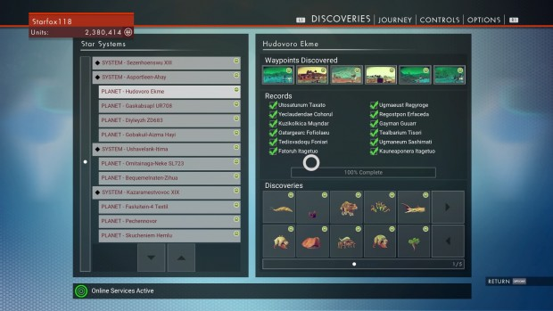
However, the game at release found itself being almost a scam as it had numerous technical issues, bugs, horrible optimization, removed features, among others, including a poorly designed menu interface.
To confirm an action, you must hold the button instead of pressing it once.
The information given upfront is irrelevant and unnecessary for the player where vital data is hard to find or non existent.

Slide 6
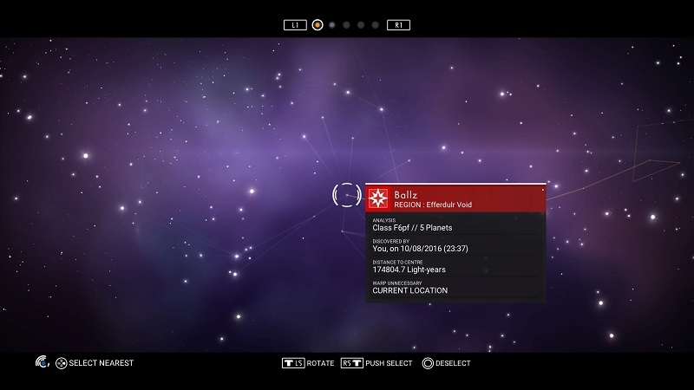
The universe map exploration menu is, as well, a lacklustre example of bad interface. Poorly navigation controls setup, absolutely irrelevant data given yet simple actions like backtracking to places previously explored are not found or are extremely complicated.
Frustrating controls and action methods;
Inadequate choice of data presentation;
Not easy in the eyes;
Poor navigation in general.

Slide 7
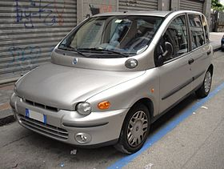
Fiat Multipla
The Fiat Multipla (Type 186) is a compact MPV produced by Italian automaker Fiat from 1998 to 2010. Based on the Fiat Brava, the Multipla was shorter and wider than its rivals. It had two rows of three seats, while all its competitors had two seats in the front (the Honda FR-V, which has the same layout, was released in 2004).

Slide 8
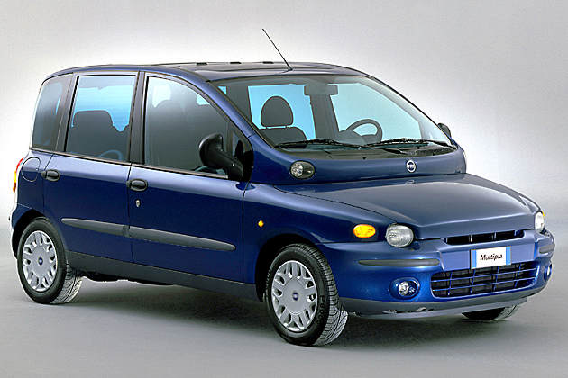
Notoriously, the vehicle is ugly, poorly designed. The front is hardly aesthetic, too big yet the space given inside is nothing to be amazed, a rather underwhelming car with below average conditions by today’ standards.
Unappealing aspect, bad design in general;
The size of the vehicle does not represent the comfort inside or its carrying capacity;
Performance under average and obnoxious to drive due to its size and length.

Slide 9
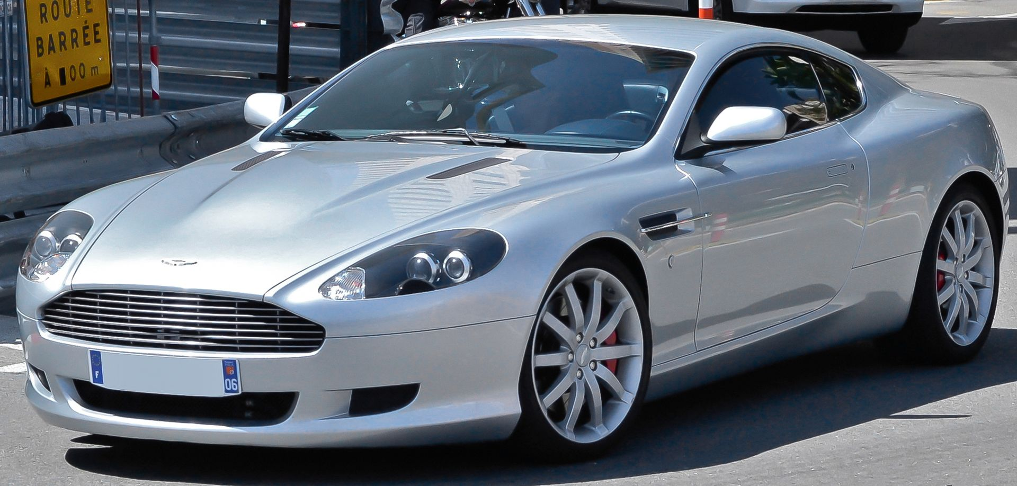
Aston Martin DB9
The Aston Martin DB9 is a grand tourer first shown by Aston Martin at the 2003 Frankfurt Auto Show. Available both as a coupe and a convertible known as the Volante, the DB9 was the successor of the DB7. It was the first model built at Aston Martin's Gaydon facility.
The DB9 is rated well by car critics, who appreciate the car's interior and exterior design, with excellent driver experience.

Slide 10
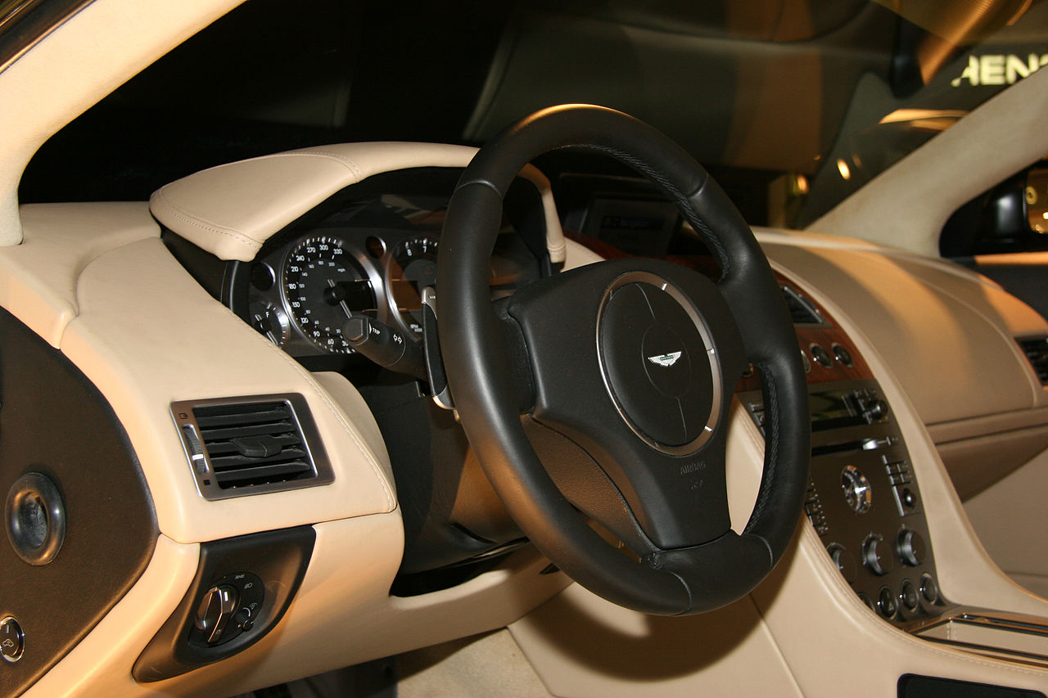
Being a good example of an appealing vehicle with a cost representative of its quality, DB9 is nothing short of great design and well received criticisms by its users as a comforting, powerful, beautiful car that fulfils its role as an excellent driver experience.
Flawless driving experience, comforting and soothing, with a small touch of power;
Amazing interior and exterior design overall;
A great feeling of accomplishment to have such car as it is indeed as good as it looks.

Slide 11
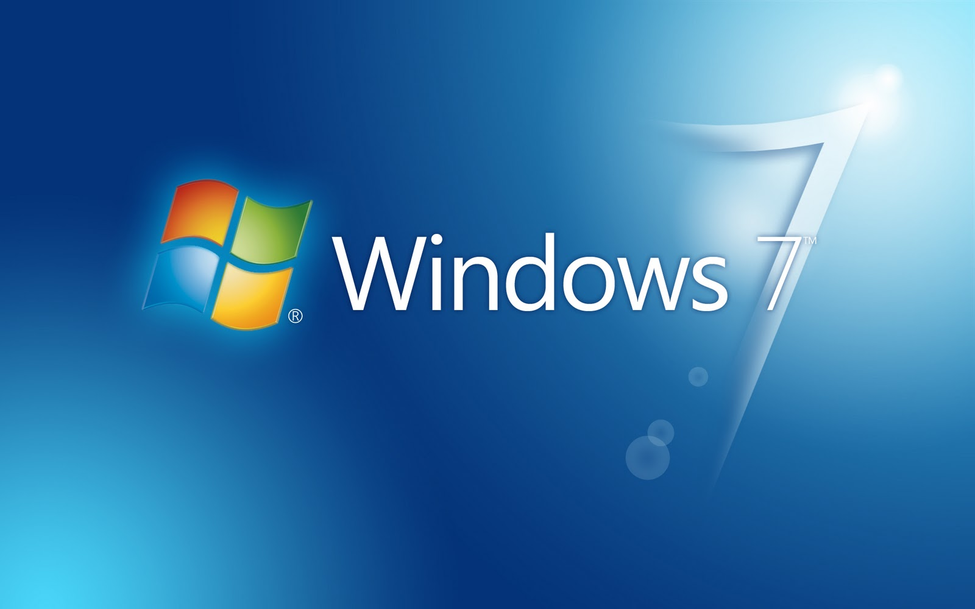
Windows 7
Windows 7 is a personal computer operating system developed by Microsoft. It is a part of the Windows NT family of operating systems. Windows 7 was released to manufacturing on July 22, 2009, and became generally available on October 22, 2009, less than three years after the release of its predecessor, Windows Vista.

Slide 12
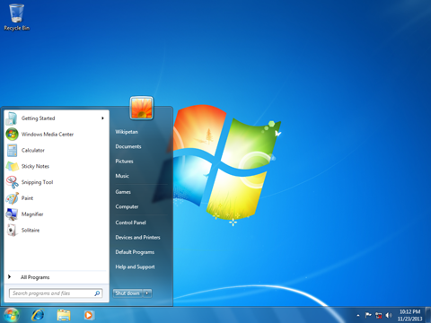
For most people, Windows 7 was probably the favourite development of all the Windows software we have worked with and most likely the one where we felt more at ease. Having remarkable easy access navigation, nostalgic use from previous old Windows from oldest generations, it was truly an upgraded version of what most wished for.
Easy on the eyes, comfortable for use;
Nostalgic use of previous versions who most were acquainted with, upgraded in every department;
Good navigation and intuitive data placement.

Slide 13
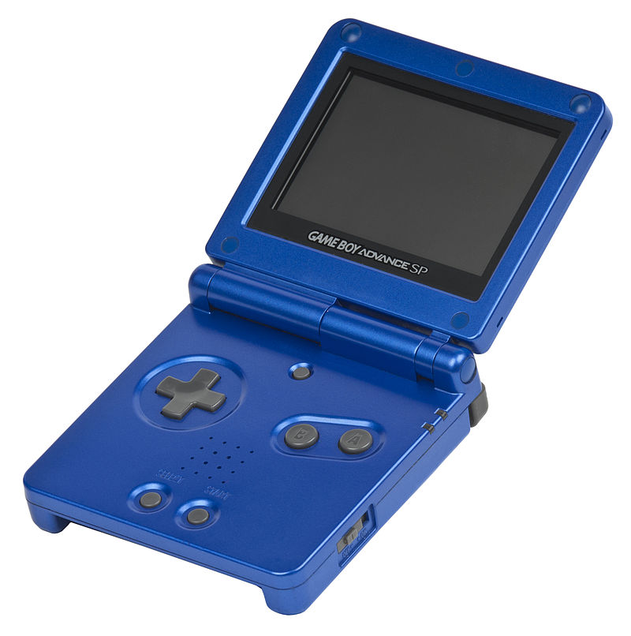
Game Boy Advance SP
The Game Boy Advance SP released in February 2003, is an upgraded version of Nintendo's Game Boy Advance. The "SP" in the name stands for "Special”. With rechargable lithium batteries and slightly more than half the size of the GBA when closed and roughly the height of Nintendo's Game Boy Color when open.

Slide 14
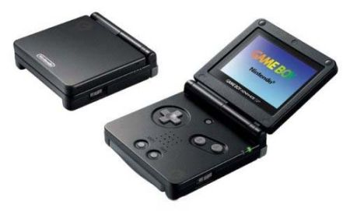
A considerable innovation following the previous release of Game boy Advance, the aesthetic simple nature of SP and the upgrades in general made a huge success in the market overall.
Vastly improved version roughly the same price than the previous one
Overall great design in appearance and simplicity, the buttons all well placed for the fingers.
Comfortable in usage;
Extremely portable due to its size and weight;

